Slide 1
Earth Berming
This technique is used both for passive cooling as well as heating of buildings, a feat which is made possible by the earth acting as a massive heat sink.
Summer as well as winter variations die out rapidly with increasing depth from the earth's surface.
This temperature at a depth of a few meters remains almost stable throughout the year.
Thus, the underground or partially sunk buildings would provide both cooling (in the summer) and heating (in the winter) to the living space.
Besides, load fluctuations are reduced by the addition of earth mass to the thermal mass of the building. The infiltration of air from outside is reduced.

Slide 2
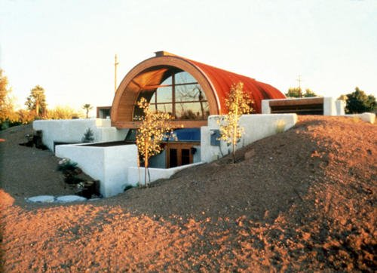
The earth sheltered structure has to be heavier and stronger to withstand the load of the earth and the vegetation above.
Besides, it should be suitably waterproofed and insulated to avoid ground moisture.

Slide 3
Earth Air Tunnels
Daily and annual temperature fluctuations decrease with the increase in depth below the ground surface.
At a depth of about 4 m below ground, the temperature inside the earth remains nearly constant round the year and is nearly equal to the annual average temperature of the place
A tunnel in the form of a pipe or otherwise embedded at a depth of about 4 m below the ground will acquire the same temperature as the surrounding earth at its surface.
Therefore, the ambient air ventilated through this tunnel will get cooled in summer and warmed in winter and this air can be used for cooling in summer and heating in winter

Slide 4
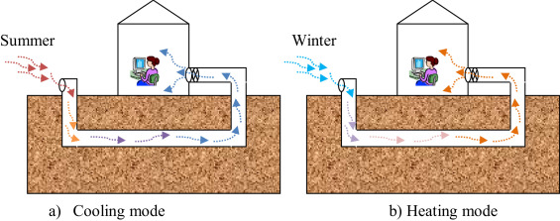

Slide 5
EVAPORATIVE COOLING
Evaporative cooling lowers indoor air temperature by evaporating water.
It is effective in hot and dry climate where the atmospheric humidity is low.
In evaporative cooling, the sensible heat of air is used to evaporate water, thereby cooling the air, which, in turn, cools the living space of the building.
Increase in contact between water and air increases the rate of evaporation.
The presence of a water body such as a pond, lake, and sea near the building or a fountain in a courtyard can provide a cooling effect.

Slide 6
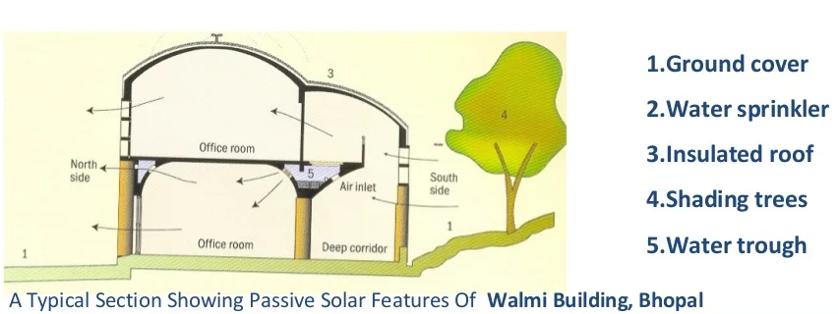

Slide 7
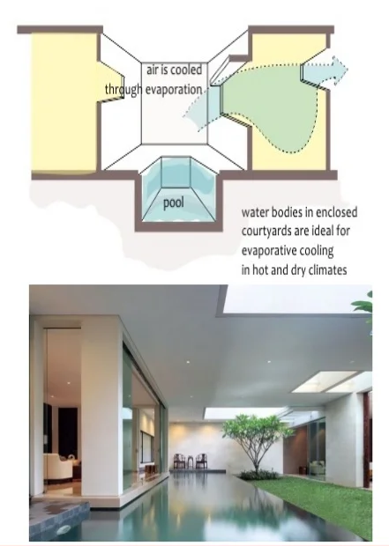
Roof Pond System
Water has a moderating effect on the air temperature of the climate. It has much higher thermal storage capacity much higher than other building material like brick, concrete etc.
Water evaporation has a cooling effect on the surroundings.
It takes up heat from the air through evaporation and causes significant cooling.

Slide 8
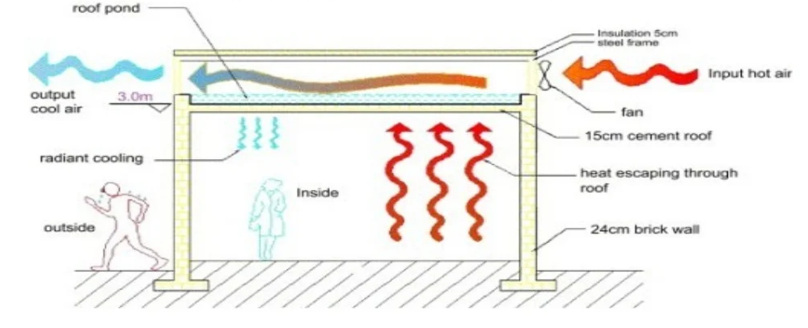

Slide 9
During the day, cool ponds absorbing room heat conducted trough the interior ceiling
At night, the pond loses heat by radiation to the night sky and by natural convection to the air
Roof pond system are effective in regions of low humidity and clear summer nights
For best cooling result, ponds can range from 6 to 12 inches deep

Slide 10
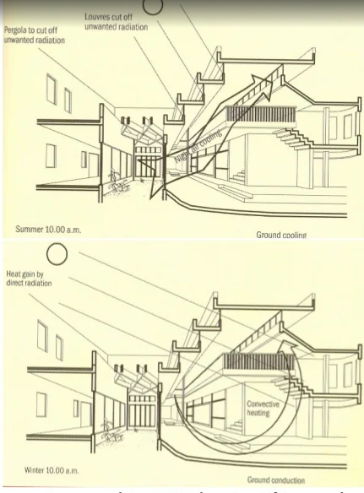
Courtyard
Due to incident solar radiation in a courtyard, the air gets warmer and rises
Cool air from the ground level flows through the louvered openings of rooms surrounding a courtyard, thus producing air flow
At night, the warm roof surface get cooled by convection and radiation
If this heat exchange reduces roof surface temperature to wet bulb temperature of air, condensation of atmospheric moisture occurs on the roof and the gain due to condensation limits further cooling

Slide 11
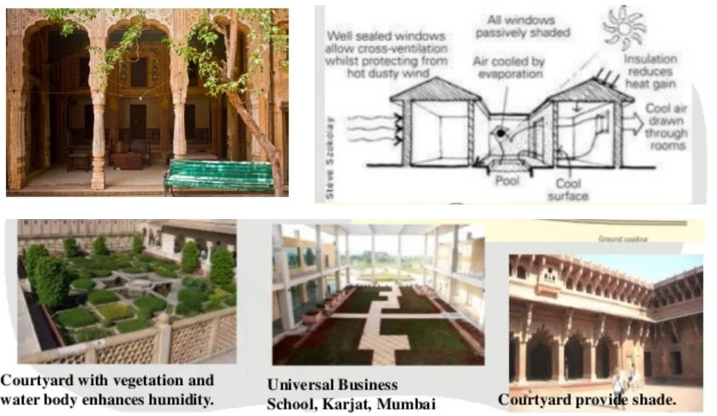

Slide 12
PASSIVE SOLAR LIGHTING
Solar Daylighting, also known as passive lighting, is a form of passive solar design.
Daylighting uses direct, diffused or reflected sunlight to provide supplemental lighting for building interiors.
Daylighting can fully replace electric lights, or it can be used to cut down on electrical costs by supplementing electrical lighting already being used.
Solar daylighting primarily occurs through large windows (facing south in the Northern Hemisphere).
Buildings that use solar daylighting require specific placement and spacing of windows.
For example, windows that are higher up on a wall distribute sunlight better.

Slide 13
Clerestory windows
Clerestory windows (a row of windows located at the top of a wall, near the roof) are an important part of daylighting in museums and churches.
Skylights, when combined with sensors and other lighting elements, can ensure that lighting inside a building stays even.
Chemical compounds in windows for solar daylighting can be made part of window glass or placed between the panes of double- and triple-paned windows.
These compounds can boost how much solar energy a window can store. They can also increase the insulating capacity of windows.

Slide 14
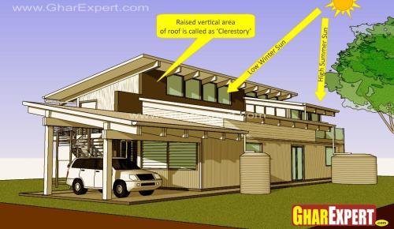
Coatings and glazings on the windows can control the amount of light or heat. The heating effect of daylighting can be increased by window coatings that are antireflective.
Some window coatings can carry an electric current that can moderate how much light or heat is let in based on weather conditions.
One type of glazing can allow a measured amount of light to pass through a window while keeping heat out.

Slide 15
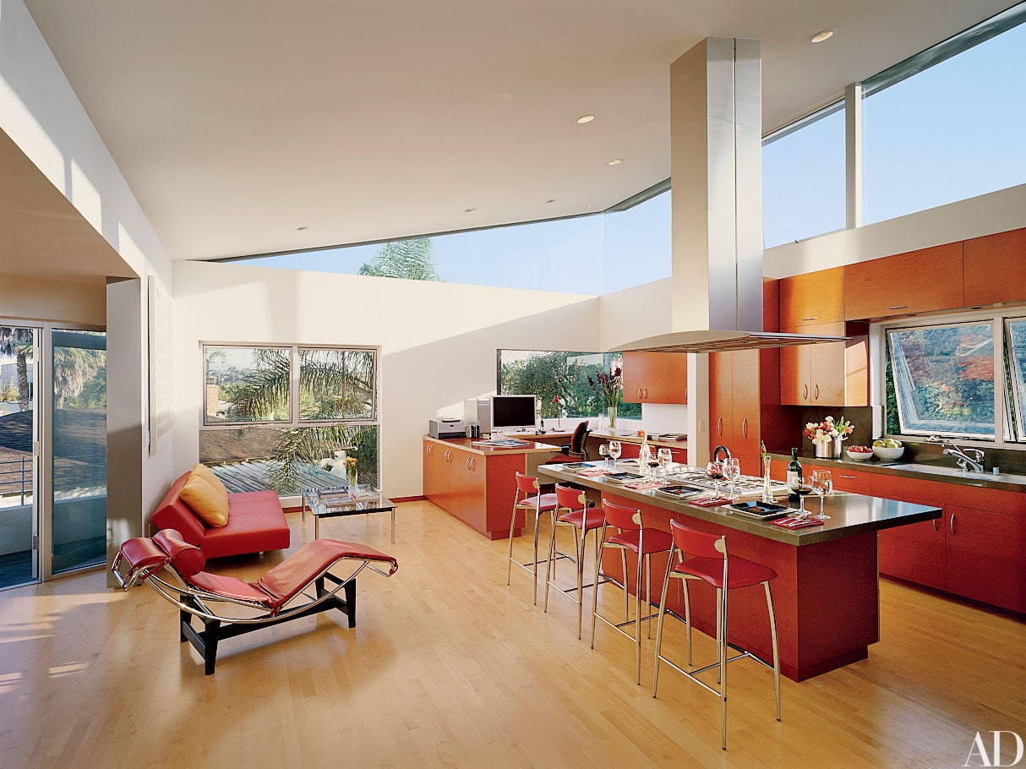

Slide 16
Skylights
Skylights are often used for daylighting.
White translucent acrylic is a 'Lambertian Diffuser' meaning transmitted light is perfectly diffused and distributed evenly over affected areas.
This means, among other advantages, that light source quality standards are measured relative to white acrylic transmission.
Skylights admit more light per unit area than windows, and distribute it more evenly over a space.
They are a good choice when daylight is being used to illuminate a space. The optimum number of skylights (usually quantified as "effective aperture") varies according to climate, latitude, and the characteristics of the skylight, but is usually 4-8% of floor area.

Slide 17
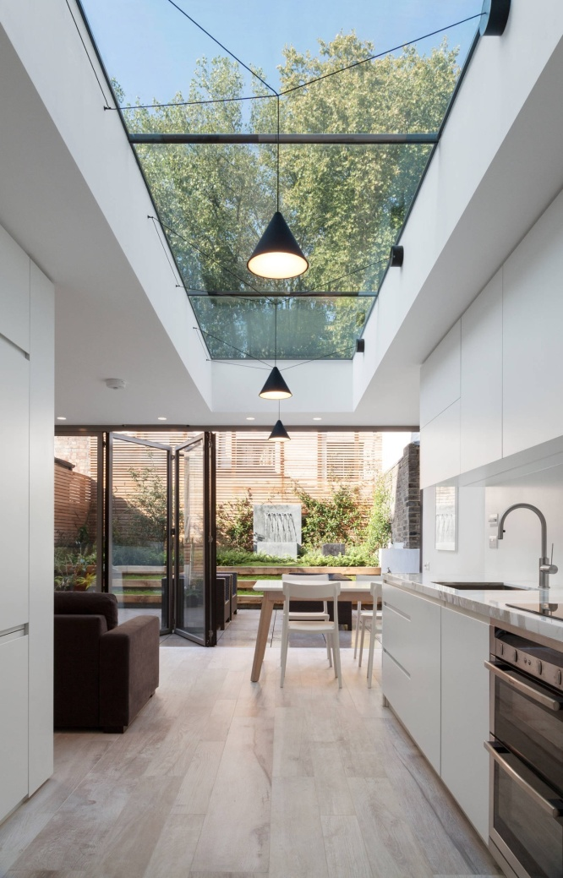
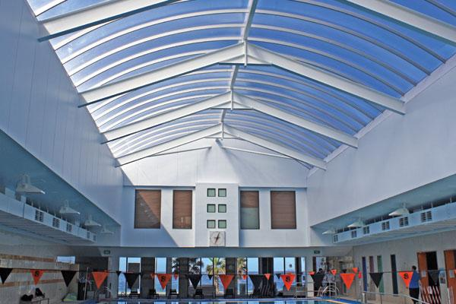

Slide 18
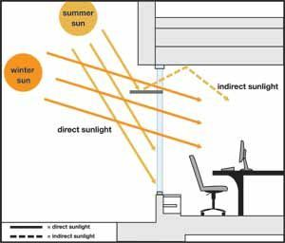
Light shelves
Light shelves can also be used.
They are placed so that the sunlight drawn in by the windows is reflected and lights a room from top to bottom.
These shelves can bring natural light deeper into a room

Slide 19
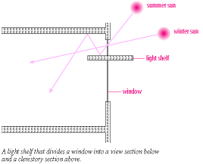
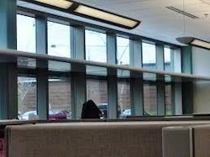

Slide 20
Passive Solar collection
A passive solar system typically relies on south-facing windows as collectors to capture solar energy, although some systems may also use supplemental PV panels.
In any case, the goal is to redistribute the energy collected according to a fundamental law of thermodynamics, which states that heat moves from warm to cool areas and surfaces.
The simplest method of transferring the heat from passive solar collectors is through convection.
To illustrate, think of a sunroom with windows on a southern wall.
As the sun's rays travel through the glass, the heat is directed into the room. It then rises to areas where the air is cooler, including other rooms beyond and above.

Slide 21
A passive solar strategy
A passive solar system does not involve mechanical devices or the use of conventional energy sources beyond that needed to regulate dampers and other controls, if any.
Classic examples of basic passive solar structures are greenhouses, sunrooms and solariums -- as the sun's rays pass through the glass windows, the interior absorbs and retains the heat.
Modeling this concept in your home can cut heating costs by half compared to heating the same home by traditional means without the use of passive solar.
In terms of design, success of the passive solar system depends on orientation and the thermal mass of the structure's exterior walls, which means their ability to store and redistribute heat

Slide 22
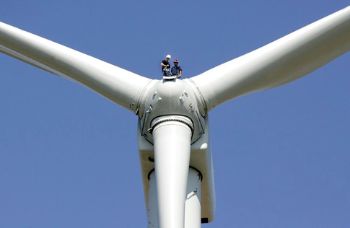
Wind and other renewable Energies
Wind
Wind turbines operate on a simple principle. The energy in the wind turns two or three propeller-like blades around a rotor. The rotor is connected to the main shaft, which spins a generator to create electricity.

Slide 23
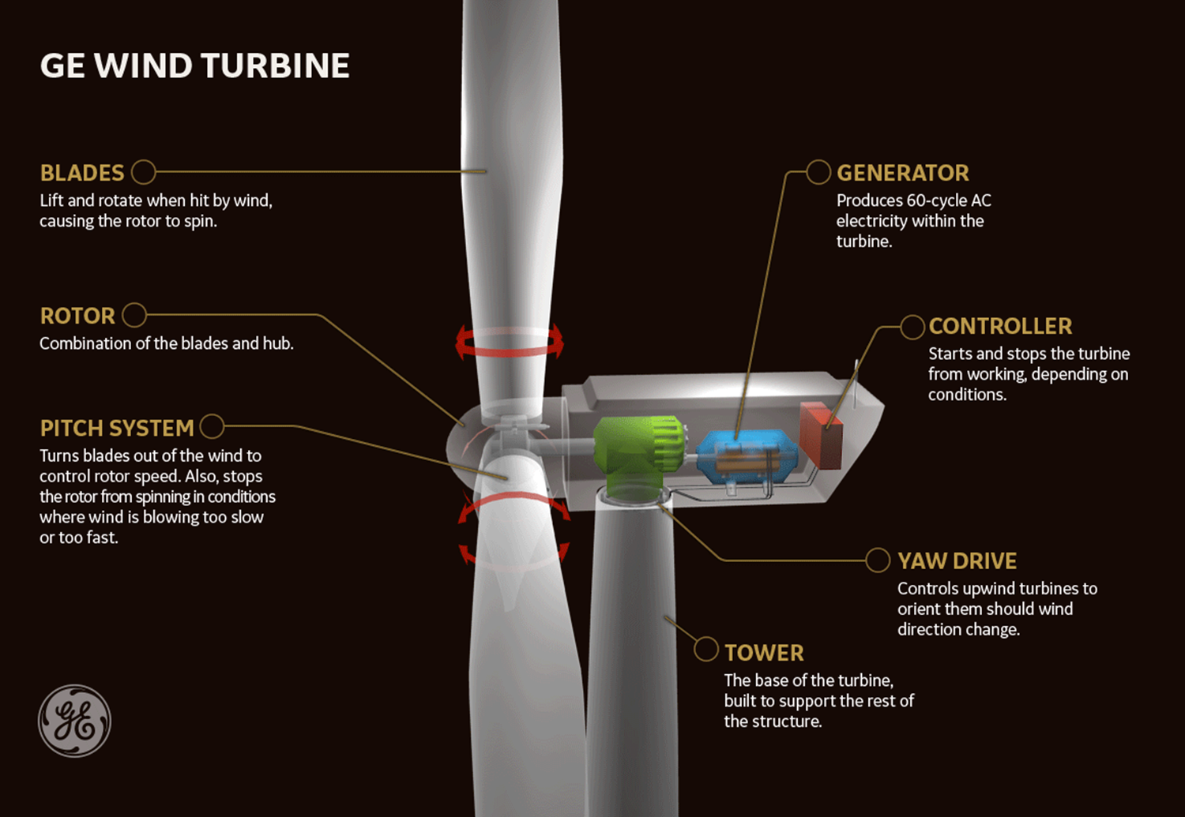

Slide 24
Wind turbines are mounted on a tower to capture the most energy.
At 100 feet or more above ground, they can take advantage of faster and less turbulent wind.
Wind turbines can be used to produce electricity for a single home or building, or they can be connected to an electricity grid for more widespread electricity distribution.

Slide 25
Advantages of Wind Energy
Clean and renewable source of power
Cost effective
Rapid growth of industry, large potential
Disadvantages of Wind Energy
Wind reliability
Threat to wildlife
Noise and visual pollution

Slide 26
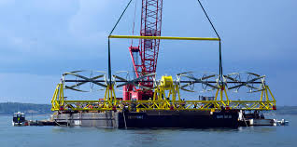
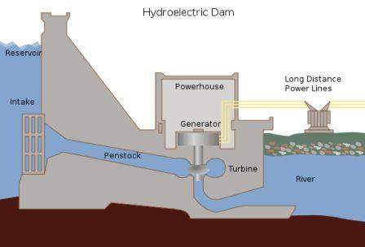
Tidal Energy
Tidal Stream Generator
Makes use of the kinetic energy of moving water to power turbines, in a similar way to wind turbines that use wind to power turbines.
Tidal Barrage
Tidal barrages make use of the potential energy in the difference in height between high and low tides.

Slide 27
Advantages
Clean fuel source compared to fossil fuels
Domestic source of energy
Disadvantages
Tidal power can have effects on marine life.
The turbines can accidentally kill swimming sea life with the rotating blades.
Some fish may no longer utilize the area if threatened with a constant rotating or noise-making object.
Installing a barrage may change the shoreline within the bay or estuary, affecting a large ecosystem that depends on tidal flats

Slide 28
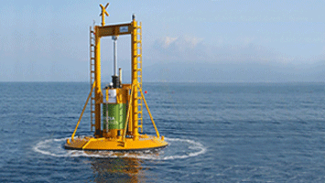
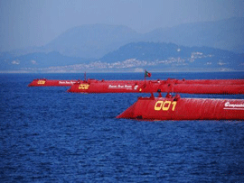
Wave Energy
Ocean waves contain tremendous energy potential.
Wave power devices extract energy from the surface motion of ocean waves or from pressure fluctuations below the surface.

Slide 29
Advantages
Renewable
Environmentally friendly compared to fossil fuel energy
Variety of designs to use
Less energy dependence from foreign governments
Disadvantages
Can affect the marine environment
May disturb private or commercial shipping
Dependent on wavelength for best operation
Poor performance in rough weather
Visual/noise issues

Slide 30
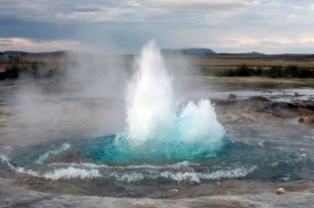
Geothermal Energy
geo = earth and thermal = heat, geothermal energy comes from heat produced by the Earth.
Direct geothermal energy can be accessed in areas where hot springs/geothermal reservoirs are near the surface of the Earth.
Geothermal heat pumps utilizes a series of underground pipes, an electric compressor and a heat exchanger to absorb and transfer heat.
Geothermal power plants also harness the heat of the Earth through hot water and steam. In these plants, heat is used to generate electricity.

Slide 31
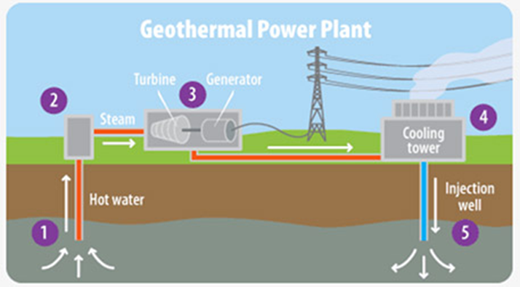
Advantages
Renewable energy
Cleaner than burning fossil fuels
Disadvantages
Cost of drilling, researching proper areas
Requires a suitable location

Slide 32


Biofuels
The two most common types of biofuels are ethanol and biodiesel

Slide 33
Ethanol is an alcohol.
Ethanol is mostly used as a fuel additive to cut down a vehicle's carbon monoxide and other smog-causing emissions.
Biodiesel is made by combining alcohol (usually methanol) with vegetable oil, animal fat, or recycled cooking greases.
It can be used as an additive to reduce vehicle emissions (typically 20%) or in its pure form as a renewable alternative fuel for diesel engines.

Slide 34
Advantages
Easy to source
Renewable
Reduces greenhouse gases
Reduced dependence on foreign energy
Disadvantages
Higher cost of production (lower supply than gasoline)
Monoculture
Shortage of food
Water Use

